Slide 1


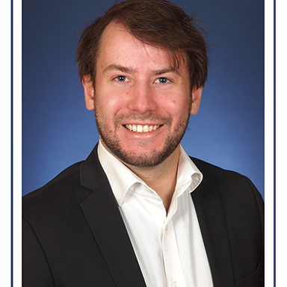
Torben Sternberg
SELECTED EXPERIENCE
Measuring Solutions for Energy Flows @ Energy & Flow Measurement Provider
Role Title: Project Engineer
Creating measurement concepts for energy flows via smart meter solutions
Development of software solutions to optimize internal processes
Energy Infrastructure Research @ Air- & Spaceflight Institute
Scientific research & comparison of ML approaches for object detection
Creation of a data pipeline for automated selection, composition and preprocessing of satellite imagery
Data engineering for training data generation
Development of deep neural networks for object detection
Transport Infrastructure Research @ European Research Organization​
Scientific research on e-mobility & sector coupling
Design & implementation of a simulation environment to study charging behavior of electronic vehicles and infrastructure prerequisites
Analysis and evaluation of traffic networks and traffic flow data
Energy Solution Design @ European Energy Contractor
Profitability calculations for project proposals
Design of energy supply systems
Implementation of a project evaluation tool
ML Engineering Senior Analyst
Technology / Data & AI
torben.sternberg@accenture.com
Neuquén, Argentina
PROFESSIONAL BACKGROUND
AREA OF EXPERTISE
Master's degree in Engineering, Specialized in Machine Learning, Deep Learning and Data Science
Experience in working according to scientific standards and presenting to an international audience in English
HARD/SOFT SKILLS & TOOLS
Dev: Python
DB: PostgreSQL
OS: MacOS, Linux
AI: TensorFlow, Scikit-learn
Container: Docker
Versioning: Git
Additional Software: AnyLogic
Others: Good communication skills, Ability to solve problematic situations, Adaptability
EDUCATION
Master's degree in Industrial Engineering, with a focus in Business Studies, Process Engineering and Energy Technologies
LANGUAGES
INDUSTRY
English (Advanced)
Spanish (Intermediate)
German (Native)
Energy
Aerospace
Customer Service
Accenture Applied Intelligence
4

